Slide 1

AUDIT OBJECTIVE
The objective of an audit of financial statements prepared within a framework of recognized accounting policies, is to enable auditor to express an opinion on such financial statements (on fairness of financial report).
The auditor’s opinion helps establish the credibility of financial statements.

Slide 2
AUDIT OBJECTIVE
In the financial statements made, client is actually making a few assertions which can either be:
Implied (implicit)
Obvious (explicit, clear-cut)
EXAMPLE:
Current Assets
Cash ………………………………………..RM 50,000
..continue……

Slide 3
AUDIT OBJECTIVE
………continue…
2 explicit assertions are:
Cash exist in the company
The correct amount of cash is RM 50,000

Slide 4
AUDIT OBJECTIVE
………continue…
Other implicit assertions are:
All cash that should have been reported is included in the RM 50,000
All cash reported (RM 50,000) is own by client
There is no restriction on the use of the cash.

Slide 5
AUDIT OBJECTIVE
There is a top-down relationship from financial statements to audit procedures.
Since financial statements contain management assertions on various financial statements’ components, auditor develops audit objectives for each relevant management assertion and then, conduct audit procedures to gather evidence.

Slide 6
AUDIT OBJECTIVE
Audit procedures to gather evidence are aimed at testing whether the audit objectives are being met.
The results from applying audit procedures will provide evidence that support auditors conclusion on the fairness of management assertions and also financial report.

Slide 7
CATEGORIES OF MANAGEMENT’S FINANCIAL STATEMENT ASSERTIONS
Existence and Occurrence
Assets and liabilities of the entity exist at a given date, and revenue and expense transactions occurred during a given period.

Slide 8
CATEGORIES OF MANAGEMENT’S FINANCIAL STATEMENT ASSERTIONS
Completeness
All transactions and accounts that should be included in the financial statements are so included.

Slide 9
CATEGORIES OF MANAGEMENT’S FINANCIAL STATEMENT ASSERTIONS
Rights and Obligations
Assets are the rights of the entity and liabilities are the obligations of the entity at a given date.

Slide 10
CATEGORIES OF MANAGEMENT’S FINANCIAL STATEMENT ASSERTIONS
Valuation and Allocation
Assets, liabilities, revenue, and expense components have been included in the financial statements at appropriate amount.

Slide 11
CATEGORIES OF MANAGEMENT’S FINANCIAL STATEMENT ASSERTIONS
Presentation and Disclosure
Particular components of the financial statements are properly classified, described, and disclosed.

Slide 12
AUDIT OBJECTIVES DEVELOPED BY AUDITOR TO CONFIRM MANAGEMENT ASSERTIONS
1. Validity
Transactions in the accounts are valid
2. Completeness
All existing transactions are included in the accounts.

Slide 13
AUDIT OBJECTIVES DEVELOPED BY AUDITOR TO CONFIRM MANAGEMENT ASSERTIONS
3. Cut-Off
Transactions in the accounts are recorded in the proper period.
4. Ownership
Transactions in the account are owned.

Slide 14
CATEGORIES OF MANAGEMENT’S FINANCIAL STATEMENT ASSERTIONS
5. Accuracy
Transactions or amounts included in the account are properly accumulated from journals and ledgers.
6. Valuation
Transactions in the account are properly valued.

Slide 15
CATEGORIES OF MANAGEMENT’S FINANCIAL STATEMENT ASSERTIONS
7. Classification
Transactions in the account or financial statements are properly classified.
8. Disclosure
All proper disclosures are made in financial statements or notes.

Slide 16
CATEGORIES AND TYPES OF EVIDENTIAL MATTERS
Evidential matter is evidence used to test the audit objectives. It consists of accounting data and all corroborative information that supports amounts included in the financial statements.

Slide 17
CATEGORIES AND TYPES OF EVIDENTIAL MATTERS
Underlying Accounting Data
Books of original entry.
General and subsidiary ledgers.
Related accounting manuals.
Informal and memorandum records (worksheets, reconciliations, computations)

Slide 18
CATEGORIES AND TYPES OF EVIDENTIAL MATTERS
Corroborating Information
Documents such as cheques, invoices, contracts, minutes.
Confirmations and other written representations.
Information from inquiry, observations, inspection, physical examination.
Other information obtained/ developed by auditor.

Slide 19
TYPES OF AUDIT PROCEDURES AND EVIDENCES
Procedures Type of Evidence
ANALYTICAL ANALYTICAL
(existence, completeness, valuation)
TRACING DOCUMENTARY
(completeness, valuation)

Slide 20
TYPES OF AUDIT PROCEDURES AND EVIDENCES
Procedures Type of Evidence
VOUCHING DOCUMENTARY
(Existence, valuation)
INSPECTING DOCUMENTARY
(existence, rights, valuation)

Slide 21
TYPES OF AUDIT PROCEDURES AND EVIDENCES
Procedures Type of Evidence
COUNTING PHYSICAL
(valuation)
OBSERVING PHYSICAL
(existence, completeness, valuation)

Slide 22
TYPES OF AUDIT PROCEDURES AND EVIDENCES
Procedures Type of Evidence
INQUIRING WRITTEN/ ORAL
(all)
CONFIRMING CONFIRMATIONS
(existence, rights, valuation)

Slide 23
TYPES OF AUDIT PROCEDURES AND EVIDENCES
Procedures Type of Evidence
REPERFORMING MATHEMATICAL
(valuation)
CAAT ELECTRONIC
(valuation)

Slide 24
DIRECTIONAL TESTING – VOUCHING AND TRACING
DIRECTION OF TESTING ASSERTION
VOUCHING EXISTENCE OR
(test for overstatement) OCCURRENCE
SOURCE DOCUMENT JOURNAL LEDGER

Slide 25
DIRECTIONAL TESTING – VOUCHING AND TRACING
DIRECTION OF TESTING ASSERTION
TRACING COMPLETENESS
(test of understatement)
SOURCE DOCUMENT JOURNAL LEDGER

Slide 26
OBTAINING AND EVALUATING EVIDENCE
Obtain evidence through audit procedure
Test of controls (eg: walk-through test)
Substantive tests (analytical procedure, details of transactions, details of balances)
Evaluate for sufficiency and competency……

Slide 27
OBTAINING AND EVALUATING EVIDENCE
…. Continue
Reasonable basis to form opinion?
If yes, unqualified, qualified, adverse (as appropriate).
If no, disclaim or qualify opinion.

Slide 28
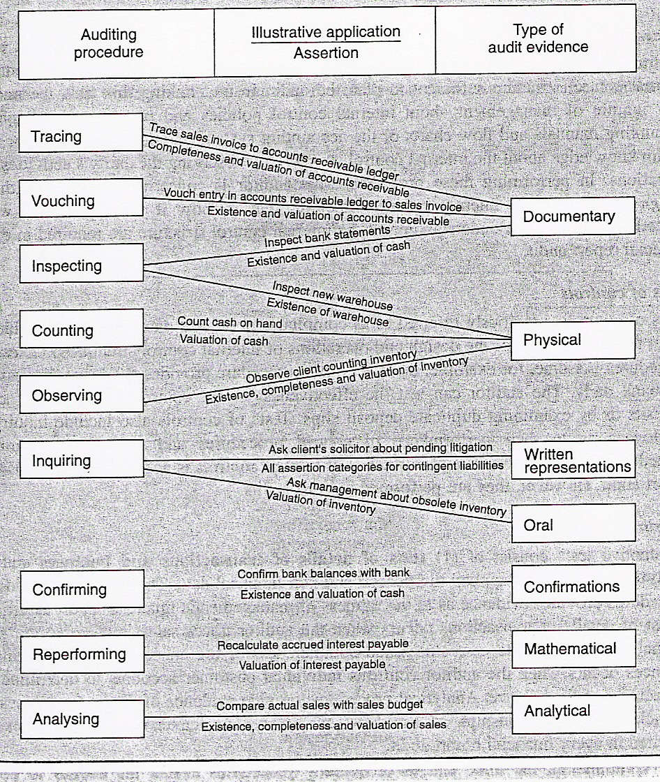
OBTAINING AND EVALUATING EVIDENCE

